Slide 1
Easy Ride
WE ARE HERE TO REMOVE LANGUAGE BARRIER
Presented By:
Kumar Sanskar (191500418)
Goldi Maurya (191500306)
Mansi Katiyar (191500441)

Slide 2
OUTLINE
About the Project
Objective
Requirements
Snapshots from the website

Slide 3
ABOUT THE PROJECT
This software EasyRide is being developed for customers so they can book their vehicle from any part of the world.
Our main motive is to remove language barrier.
This software contains 3 phrases:
1: Landing Page →
Our landing page contains login/sign up.
How its work
About section
Review section
Happy member
Terms and condition (4th page)
2: User/customer profile page →
User profile with their name and location.
Previous ride
Prime member section
3: Owner profile page →
Owner profile with their name and location.
Driver details
Vehicle details

Slide 4
OBJECTIVE
To ease customer’s requirement whenever they want to rent a car.
To remove language barrier between customer and driver.
To produce a web-based system that allow customer to login/signup can use the services effective.

Slide 5
REQUIREMENTS
Software Specification Used:-
Technology Implemented: Web Development
Language Used: HTML, CSS, JAVASCRIPT
Database: Firebase
User Interface Design: Graphical User Interface
Web Browser: Chrome/Firefox/Microsoft Edge

Slide 6
HARDWAREREQUIREMENTS •Processor: Intel-i3 or more •Operating System: Windows7 or Higher •RAM:4 GB or more •Hardware Devices: NIL •Harddisk:1TB or more •Display:13inch Laptop or Higher

Slide 7
THIS IS HOW OUR WEBSITE LOOKS
Hope you will like it :)

Slide 8
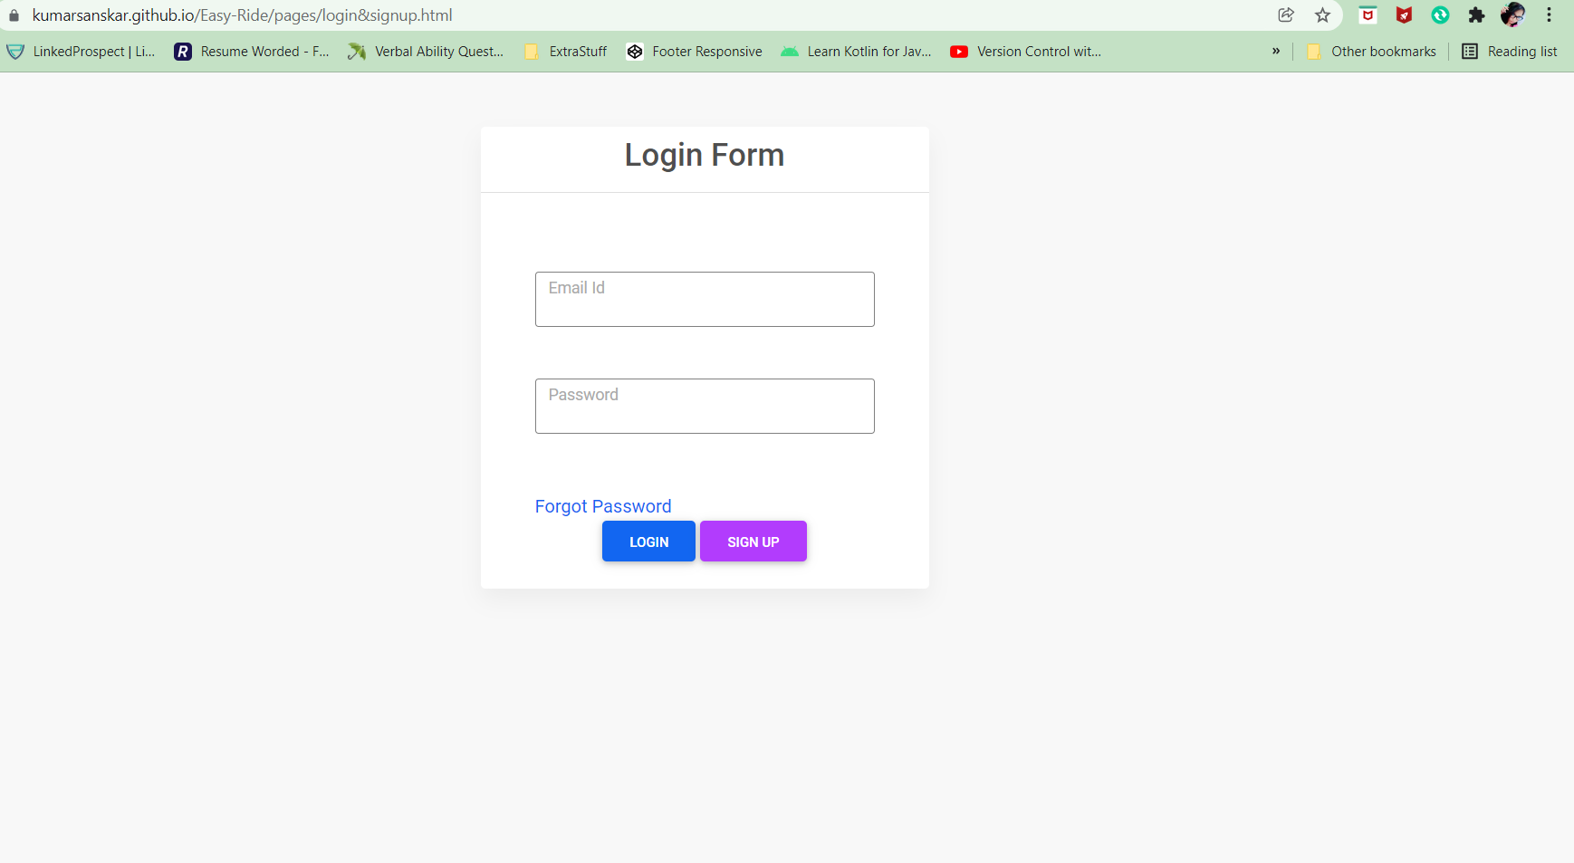
Login Page

Slide 9
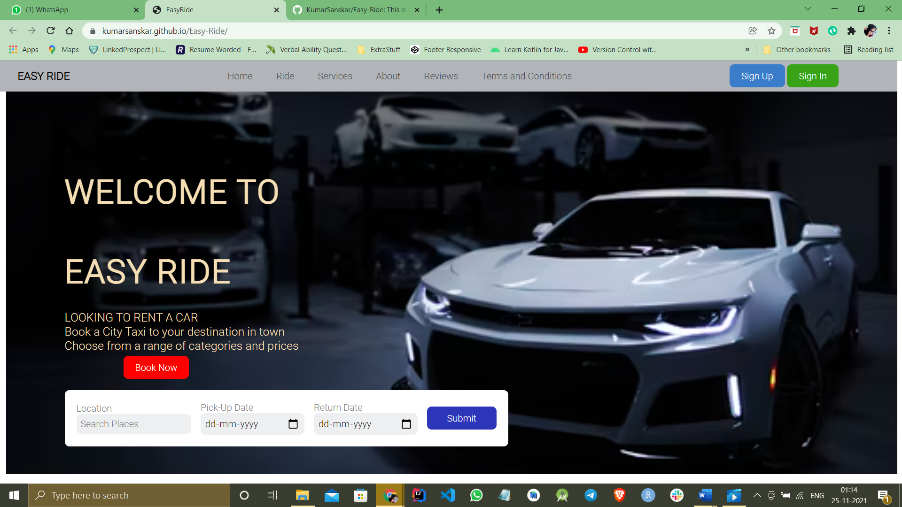
2. Landing Page

Slide 10
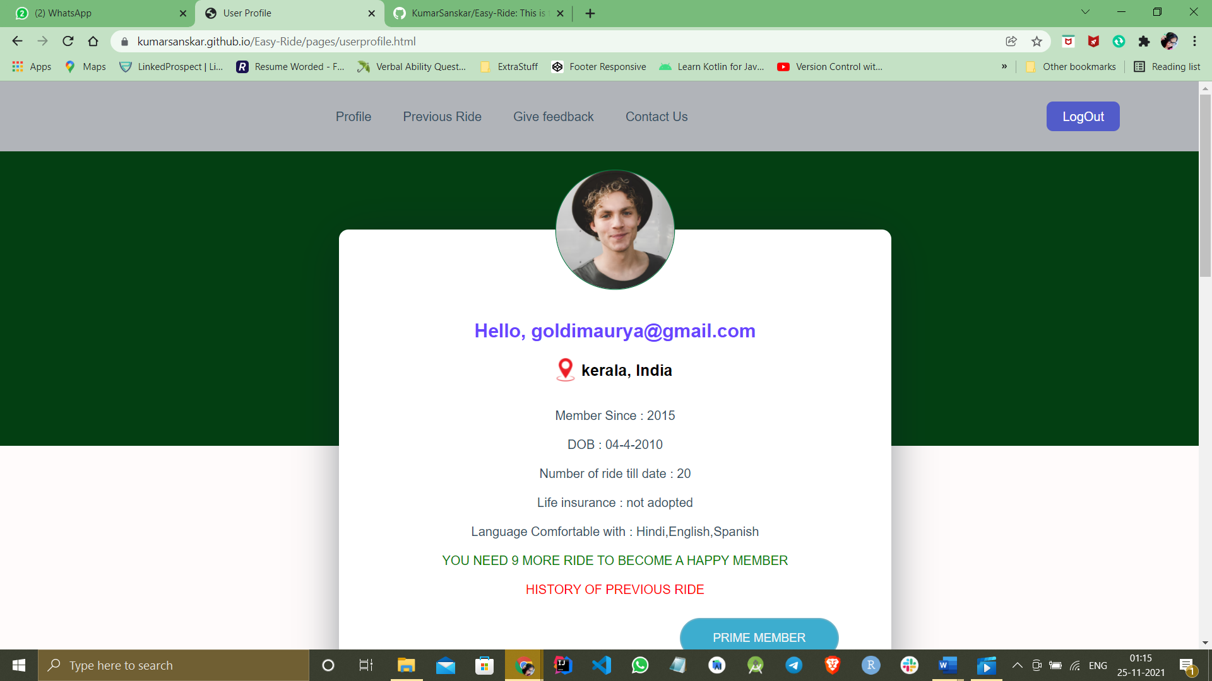
3. User Profile Page

Slide 11
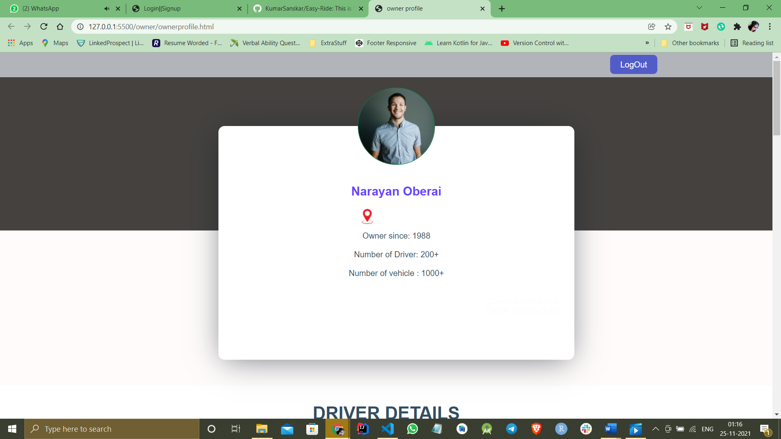
4. Owner/Admin Page

Slide 12
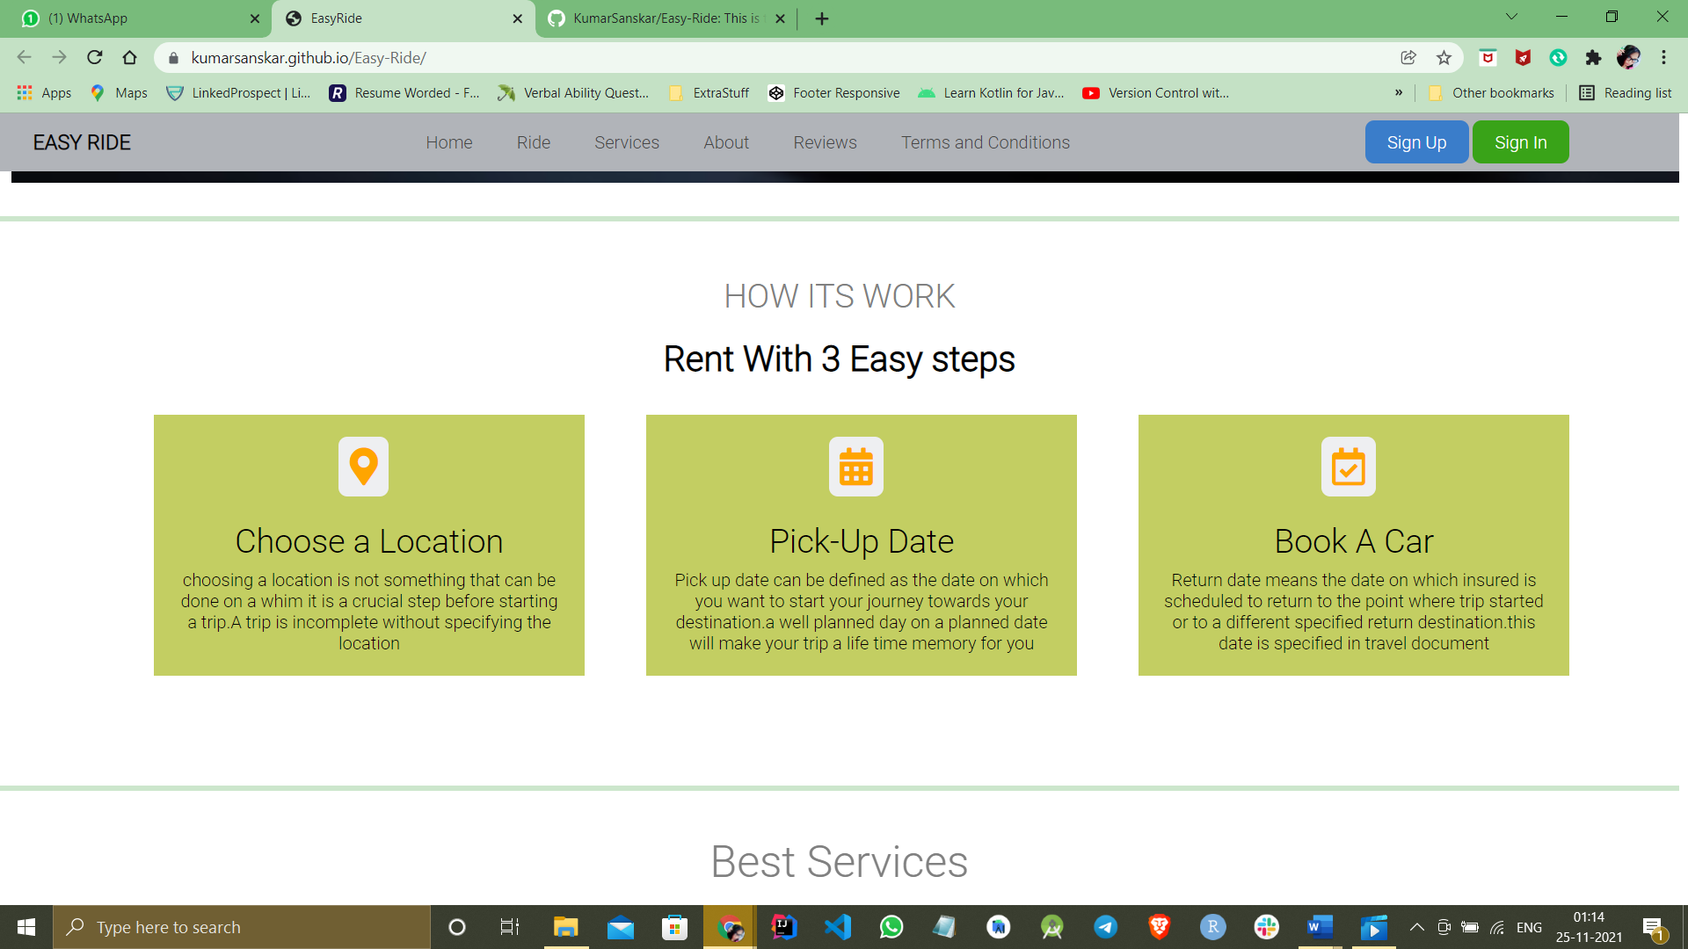
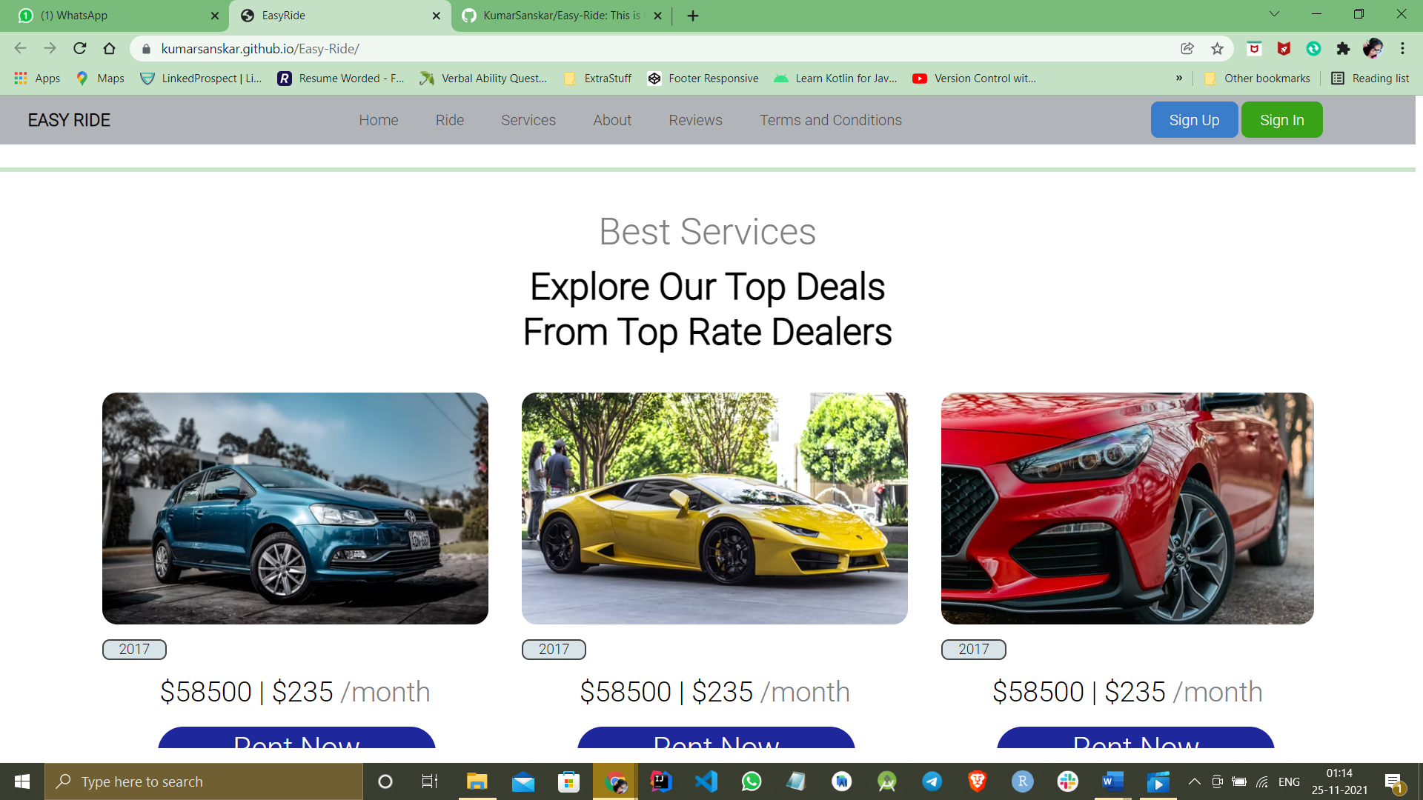
Sub section of landing page

Slide 13
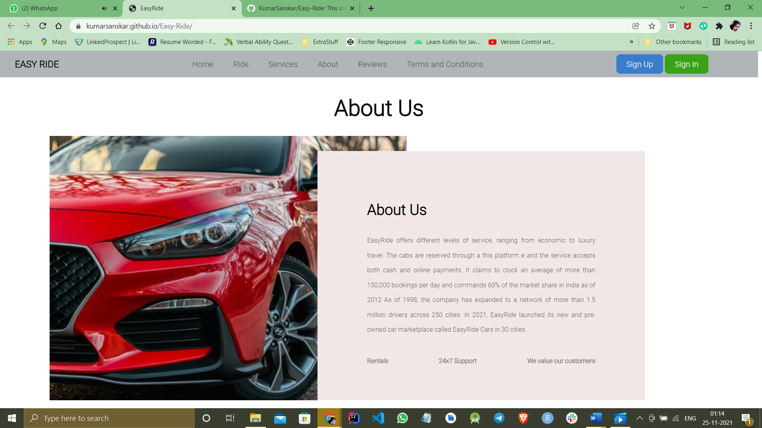
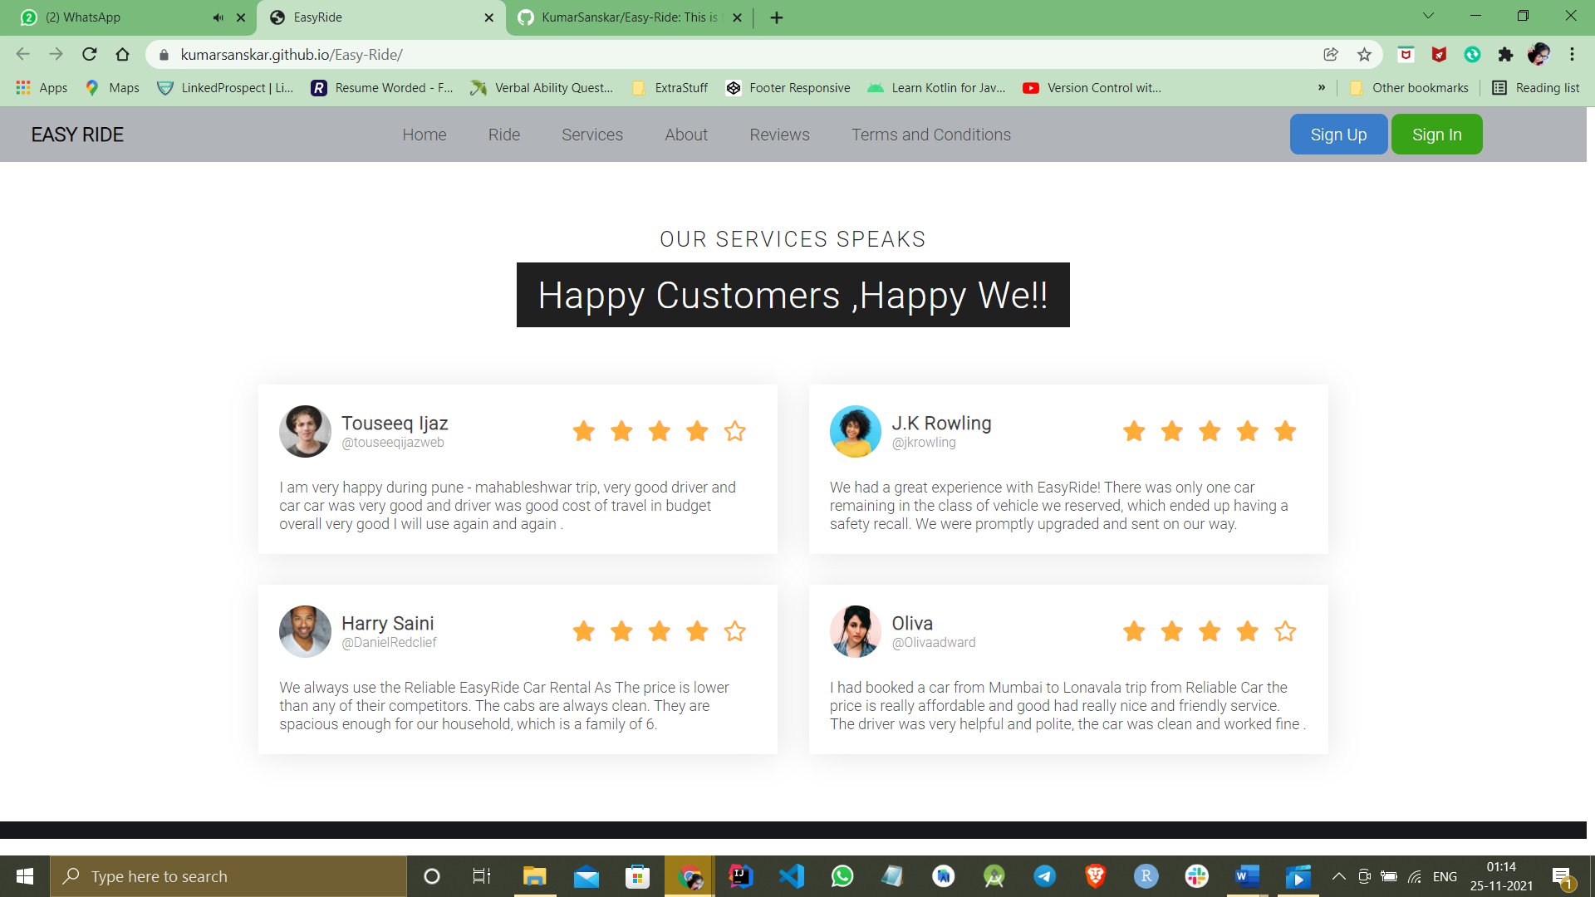

Slide 14
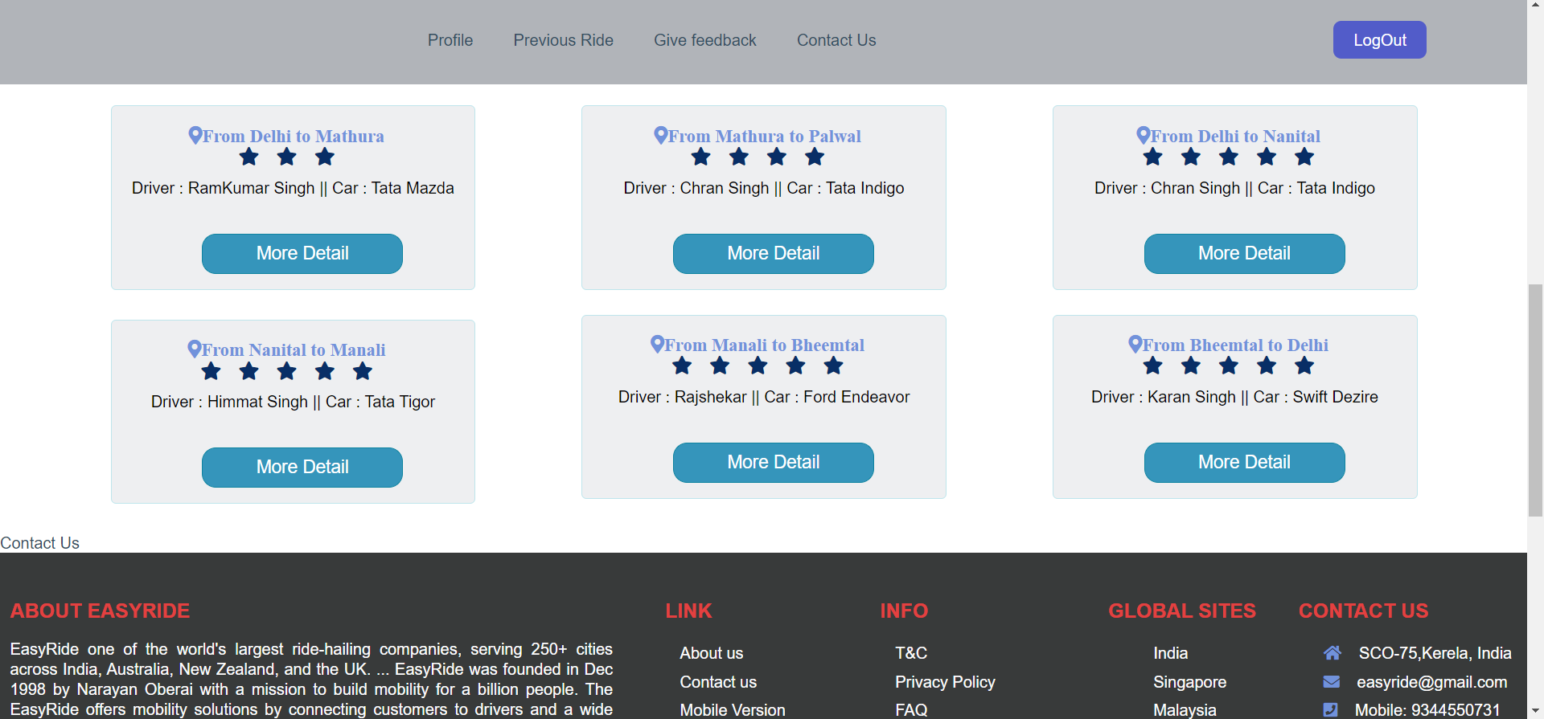
Sub section of user page

Slide 15
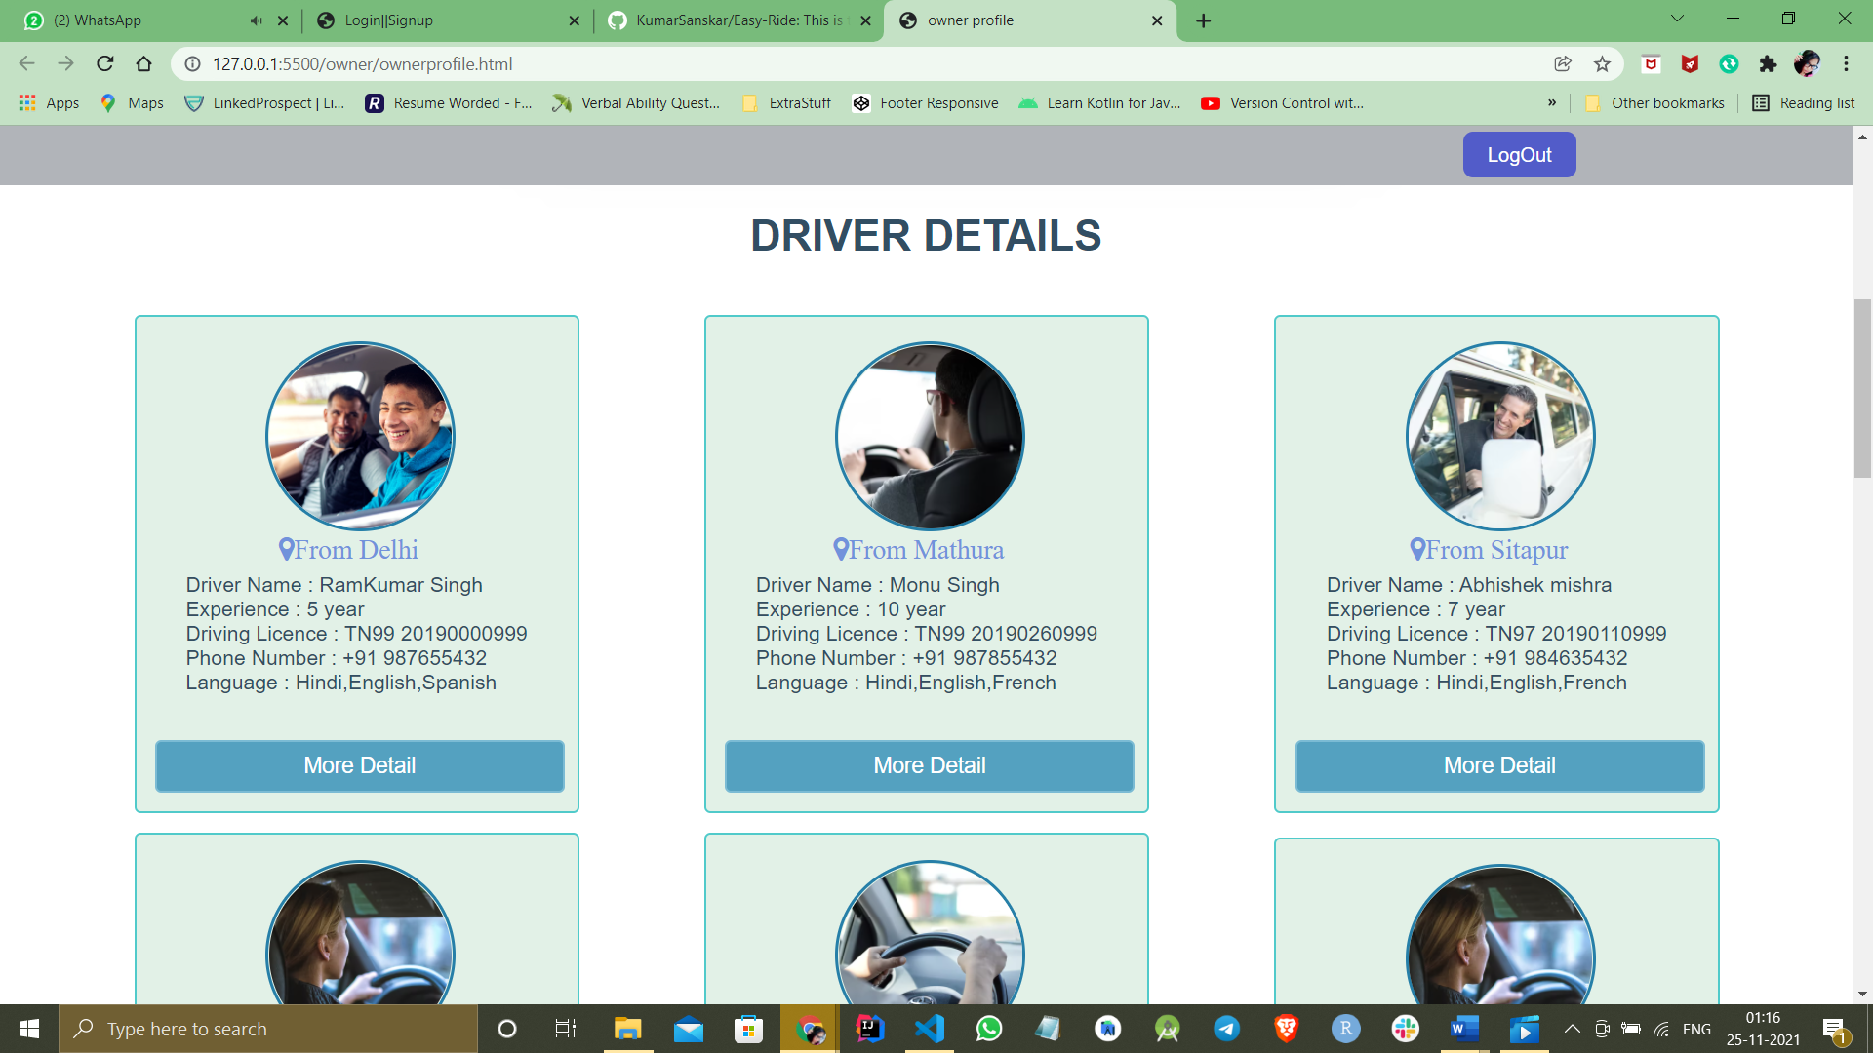
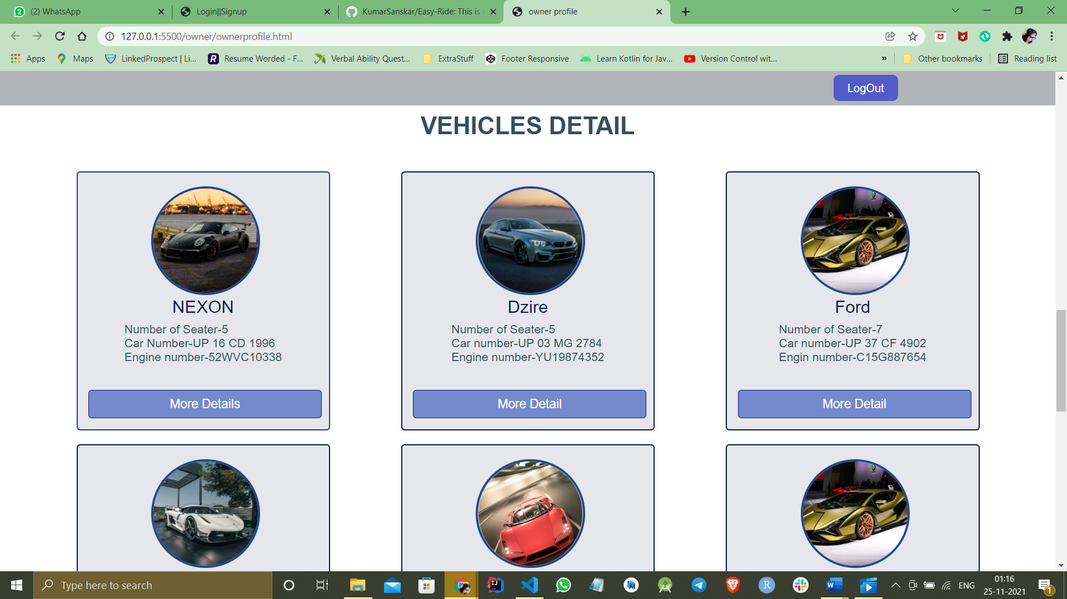
Sub section of owner page

Slide 16
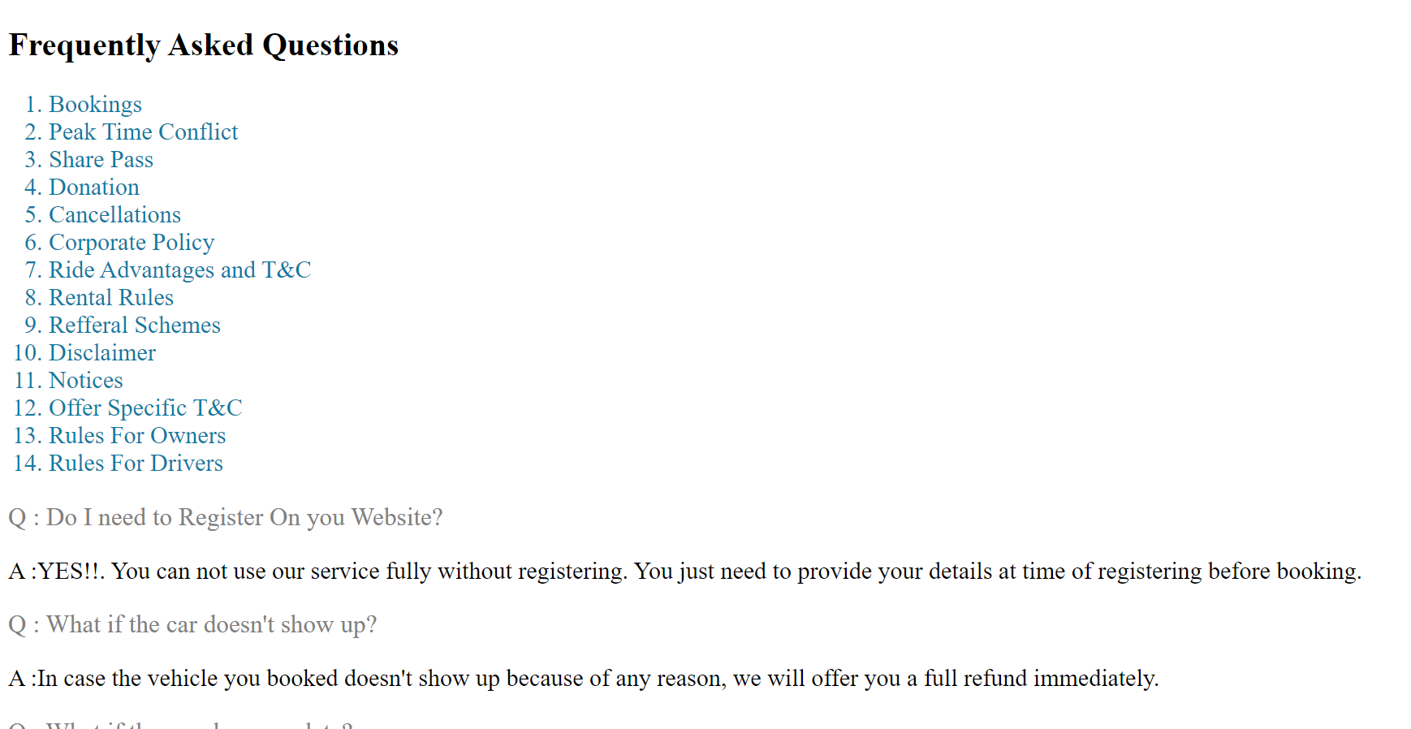
Term and condition Page

Slide 17
Thank You!!!

